Slide 1



Revisions to
CHANCELLOR'S PROCEDURE FOR POLICY
801.03: Admission: Dual Enrollment/Dual Credit for High School Students
Tessa Brown
Assistant Director of Strategic Enrollment Management – Early Programs
Alabama Community College System
12.07.2022

Slide 2

HOUSEKEEPING
Please use the chat function to ask questions or make comments.
This session will be recorded.
Dr. Neil Scott
Executive Director of Strategic Enrollment Management
Alabama Community College System
Neil.Scott@accs.edu
334.293.4575

Slide 3
THE REVIEW PROCESS
College Focus Group
Ad Hoc Committee
ACCS DE Taskforce
Chancellor Approval
K-12 Focus Group

Slide 4
ELIGIBILITY CRITERIA
Former 2.2
Current 2.2
In the absence of an Alabama driver's license or state-issued ID card, a student may provide a certified copy of their birth certificate to establish U.S. citizenship and a printout of the student information profile sheet from iNow signed and dated by their high school principal to establish current residency and identification. The profile sheet must show the student's home address and include the student's photo.
Students must comply with the identification requirements prescribed in the general admission procedure. ACCS institutions may accept a student information system profile sheet for identification.

Slide 5
ELIGIBILITY CRITERIA
Former 2.3
Current 2.3
Students must be in grade 10, 11, or 12. An exception may be granted by the Chancellor
for students documented as gifted and talented in accordance with Alabama
Administrative Code §290-8-9 .12.
Students must be rising 10th, 11th, or 12th graders as defined by each secondary education entity’s promotion/retention policy. An exception may be granted through ACCS waiver requests including but not limited to students documented as gifted under Alabama Administrative Code §290-8-9.12.
Notes:
This specification will reduce the need for waivers and also informs colleges of options for waiver requests.

Slide 6
ELIGIBILITY CRITERIA
Former 2.4
Current 2.4
Students seeking enrollment in Dual Enrollment for Dual Credit coursework must have a minimum cumulative (unweighted) high school grade point average of 2.5 on a
4.0 scale.
Students seeking enrollment in Dual Enrollment for Dual Credit coursework
must have a minimum cumulative (unweighted) high school grade point average
of 2.5 on a 4.0 scale. Exceptions may be granted per program through ACCS
waiver requests.
Notes:
This additions informs colleges of the opportunity to request waivers for GPA requirements (especially for technical programs).

Slide 7
ELIGIBILITY CRITERIA
Former 2.5
Current 2.5
Students must have written approval of the appropriate principal or career and technical
education program representative (if applicable) and counselor. Dual Enrollment for Dual Credit eligibility for students enrolled in private, home school/private tutor,
parochial, or church/religious secondary educational entities must be documented in
writing by an appropriate school official. Approval from secondary school officials
indicates that the student has demonstrated both academic readiness and social maturity.
Students must have the written approval of a secondary school official. Dual Enrollment for Dual Credit eligibility for students enrolled in private, homeschool/private tutor, parochial, or church/religious secondary educational
entities must be documented in writing by an appropriate secondary official. Approval from secondary school officials indicates that the student has demonstrated both academic readiness and social maturity.
Notes:
This change minimized the HS approval to only one signature of an individual designated by SSO (Secondary School Official).

Slide 8
CONTINUOUS ELIGIBILITY CRITERIA
Former 4
Current 4
Students who meet the criteria for initial admission to a Dual Enrollment for Dual Credit program as specified in Section 2 will maintain continuous eligibility so long as they earn a grade of C or better in all attempted college courses. Students who fail to meet this minimum grade requirement or who withdraw from a course will be suspended from the program for a minimum of one term. The one-term suspension may not be served during the summer. The student may not re-enroll until the suspension has been served. For re-entry, the student must reapply to the program and must meet the minimum grade point average requirements as identified in Section 2.4.
Students who meet the criteria for initial admission to a Dual Enrollment for Dual Credit Program, as specified in Section 2, will maintain continuous eligibility so long as they earn a grade of C or better in all attempted college courses.
Each college shall develop their own continuous eligibility appeal process. Colleges are advised to document justification for individual eligibility decisions.
Notes:
This change retains the criteria for continuous eligibility. However, it empowers colleges to develop their own processes for

Slide 9
COURSE OFFERINGS
Former 5
Current 5
Courses offered by postsecondary institutions shall be drawn from the respective institution's existing academic inventory of credit courses. Only courses required in the student's program of study will be eligible for Dual Enrollment for Dual Credit. Developmental courses (those numbered below I00) are not offered through dual enrollment. This includes developmental co-requisite courses which are required to be taken along with college-level English and math courses.
Courses offered by postsecondary institutions shall be drawn from the respective institution's existing academic inventory of credit courses.
Courses below 100 are not eligible for Dual Credit. Co-requisite courses above 100 are eligible.
Notes:
Language changed to clarify courses that are appropriate for DE credit.

Slide 10
PROVISIONS FOR DISABILITY SERVICES & ACCOMMODATIONS
Former 9
Current 9
It is the student's responsibility to disclose and provide current documentation in support of his or her request for accommodation from the disability services office of the college. Decisions regarding accommodations provided in postsecondary courses will be made by the institution upon submission of appropriate documentation. Institutions will not provide modifications to change the course content or performance expectations that would substantially alter the essential functions or physical demands of the course, unless required to do so by applicable law. Students with disabilities who meet the prerequisites of ACCS courses will be provided reasonable accommodations that allow equal access. Some accommodations available at the high school may not be provided by the postsecondary institution.
Students that submit documentation of qualifying disabilities and meet the prerequisites of ACCS courses will be provided reasonable accommodations that allow equal access. Colleges are not required to provide equivalent
accommodations as the secondary educational entity. Modification of curriculum is not permitted.
Notes:
Much of this section has been moved. Language detailing the need for documentation and differences in accommodations and modification is much stronger and more direct.

Slide 11
PAYMENT OF TUITION, FEES & ADDITIONAL ASSOCIATED COSTS
Former 10
Current 10
Students who fail to pay tuition and fees by the end of the drop/add period are not considered enrolled and may automatically be dropped from course rolls. The appropriate LEAs and/or other secondary educational entities will be notified.
Students must adhere to institutional financial policies and deadlines to avoid being automatically dropped from course rolls.
Notes:
This language changed to respect the policies of individual colleges.

Slide 12
DUAL ENROLLMENT FOR DUAL CREDIT LIMITATIONS
Former 11
Current 11
Student enrollment in a combined number of high school and college courses per term will not exceed that which is educationally sound as determined by the institution and the LEA and/or other secondary educational entity.
Student enrollment in a combined number of secondary and college courses per term will not exceed that which is educationally sound as determined by the institution and the secondary educational entity.
ACCS imposes neither semester nor lifetime credit limits for Dual Enrollment students. Credits earned in excess of the secondary educational entity’s graduation requirements might not result in dual credit on the secondary school transcript.
Notes:
This language clarifies misconceptions regarding credit and semester participation limits. This will also eliminate waiver requests regarding limits of courses per term.

Slide 13
DUAL ENROLLMENT FOR DUAL CREDIT LIMITATIONS
Former 11
Current 11
Dual Enrollment Agreements
Student enrollment in a combined number of secondary and college courses per term will not exceed that which is educationally sound as determined by the institution and the secondary educational entity.
ACCS imposes neither semester nor lifetime credit limits for Dual Enrollment students. Credits earned in excess of the secondary educational entity’s graduation requirements might not result in dual credit on the secondary school transcript.
Notes:
This language clarifies misconceptions regarding credit and semester participation limits. This will also eliminate waiver requests regarding limits of courses per term.

Slide 14
CREDIT AWARDED
Former 12.4
Current 12.4
Semester credit hours at the postsecondary level for high school courses specifically named as a requirement for graduation as outlined in AAC Rule 290-3-1-.02(8)( a) are determined according to guidelines established by the SDE. Partial/full
credit agreements shall be developed by the local board of education and participating postsecondary institutions for courses that are excluded from the SDE guidelines for assigning credit. The Dual Enrollment- High School Graduation Requirement Equivalency List developed by the SDE identifies dual enrollment courses taken through the ACCS that may satisfy one or more Alabama High School Diploma graduation requirements.
Secondary schools follow guidelines established by the State Department of Education (SDE) when assigning credit for Dual Enrollment courses that satisfy requirements for graduation as outlined in AAC Rule 290-3-1-.02(8)(a). Partial/full credit agreements shall be developed by the local board of education and participating postsecondary institutions for courses that are excluded from the State Department of Education guidelines for assigning credit. The Dual Enrollment- High School Graduation Requirement Equivalency List developed by the SDE identifies dual enrollment courses taken through the ACCS that may satisfy one or more Alabama High School Diploma graduation requirements. Course additions may be requested as needed.
Notes:
Notifies colleges of the option to request additions to Tessa Brown Tessa.brown@accs.edu or 334-453-4531.

Slide 15
TRANSCRIPTS
Former 12.5
Current 12.5
Courses approved for dual credit shall be posted on both secondary and postsecondary transcripts. Courses completed for dual credit shall be transcripted with the appropriate statement at the postsecondary level indicating dual enrollment credit. It shall be the responsibility of the postsecondary institution to report grades (in numerical format) to secondary officials. Dual Enrollment credit is transcripted conditionally until the student completes high school graduation requirements. Students must submit an official high school transcript upon graduation to finalize the awarding of college credit for dual enrollment courses.
Courses approved for dual credit shall be posted on both secondary and
postsecondary transcripts. It shall be the responsibility of the postsecondary
institution to report grades (in numerical format) to secondary officials.
Notes:
This eliminates a significant barrier that has been reported by colleges. There will no longer be a statement designating the credit as DE.

Slide 16
STUDENT ISSUES
Former 12.7
Current 12.7
The local education agency and the community college must jointly develop written policies and procedures detailing information that includes, but is not limited to, attendance and critical dates, drop/add and withdrawal policies, student code of conduct (discipline/in-school suspensions), and grading policies. The procedures shall be outlined in the Dual Enrollment Student Policies and Procedures Handbook.
The secondary educational entity must adhere to ACCS institution policies and procedures including, but not limited to, attendance and instructional dates, drop/add and withdrawal policies, student code of conduct, and grading policies.
Students should be advised that Dual Credit becomes part of their permanent college transcript and must be reported to any college attended in the future. Additionally, students should be advised of the consequences of failure or withdrawal on future financial aid availability and Satisfactory Academic Progress (SAP).
Notes:
Language is added to require colleges to advise students of potential consequences regarding dual enrollment participation.

Slide 17
PROVISIONS FOR DISABILITY SERVICES AND ACCOMMODATIONS
Former 12.8
Current 12.8
Portions of this section have moved but are retained.
Portions of this section have moved but are retained.
Notes:
Much of this section has been moved. Language detailing the need for documentation and differences in accommodations and modification is much stronger and more direct.

Slide 18
COMMUNICATION TO PARENTS AND STUDENTS
Former 12.10
Current 12.10
ACCS institution must have a provision for
communicating to parents and students the educational and economic benefits of the Dual
Enrollment for Dual Credit program as well as requirements for participation and
enrollment procedures. The institution will communicate the confidentiality requirements of the Family Education Rights and Privacy Act (FERP A) regarding college students. At a minimum, the information above will be included in the postsecondary institution's appropriate publications and on its website.
ACCS …website.
Parents may access student records regarding Dual Credit through the secondary educational entity according to the regulations set forth in the Family Education Rights and Privacy Act (FERPA) regarding college students. ACCS institutions and LEAs may share student records under FERPA under the conditions outlined in (20 U.S.C. § 1232g; 34 CFR § 99.31).
An ACCS institution may provide an Authorization for Release of Information form to allow the release of student academic records, financial information, and/or disciplinary information to parents, guardians, or others.
Notes:
Informs parents of appropriate access to information, clarifies appropriateness of information sharing between DE partners, and encourages colleges to provide release options.

Slide 19
DUAL ENROLLMENT SCHOLARSHIP FUNDS
Former 12.11
Current 12.11
CTEDE scholarship funds are contingent upon allocations by the Alabama Legislature. Colleges must begin to phase in a system to prioritize the scholarships to be awarded based on the allocation received for the Spring, Summer, and Fall semesters of the school year that funds are received. Enrollment planning and budgeting of these funds require that colleges provide annual course schedules for dual enrollment classes to the partner high schools by February 1 of each year, and that the partner high schools provide complete enrollment forms to the colleges by May 1 for enrollment in the Fall semester; November 15 for enrollment in the Spring semester; and March 1 for enrollment in the Summer semester.
Colleges may maximize the CTEDE scholarship funds by providing textbooks, tool kits, personal protective equipment, and other associated materials and supplies for student checkout, but details must be listed in the Dual Enrollment for Dual Credit Agreement.
CTEDE scholarship funds may be used to cover costs of select academic course(s) in the eligible CTE program of study but must be taken concurrently with CTE course(s). The CTEDE scholarship will cover the required English, math and science course in the eligible CTE program of student. The Anatomy and Physiology course is an exception if the dual enrolled student is on a healthcare career pathway. Students requiring developmental co-requisite courses along with college English and math courses to meet program requirements are not eligible to receive the CTEDE funds for these courses.
Scholarship funds are contingent upon allocations by the Alabama Legislature and are administered according to the direction of the ACCS Chancellor.
Notes:
This section was minimized to allow for changes that occur in DE allocations.

Slide 20
CHANGE IN STATUS NOTIFICATION
Former 14
Current 14
The appropriate secondary educational entity will be notified of any enrollment status change including but not limited to non-attendance, withdrawals, and non-payment.
Notes:
This section was added to emphasize the need to communicate with secondary partners when changes occur.

Slide 21
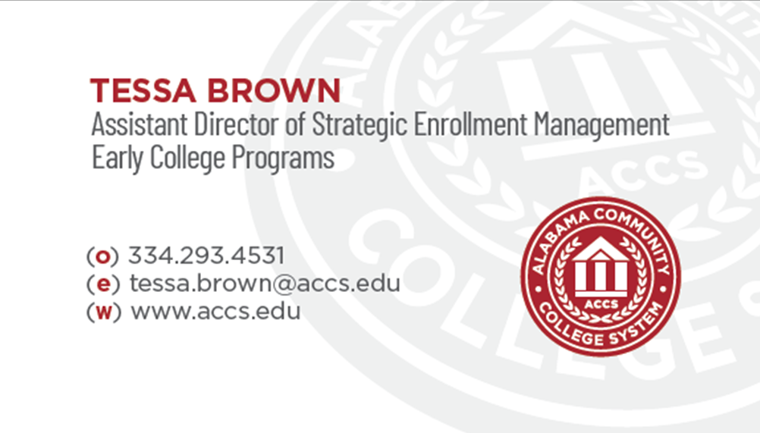
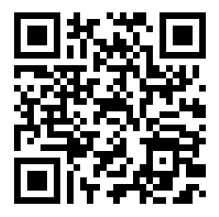
WRAP UP
Building Relationships
Invitations to visit your campus are appreciated!
Here to assist.
Cell 251.298.4792
Dual Enrollment Conference
Please complete this survey.

