Slide 1
The 3 New S’s of IT: Sectoral Shared Services
Notes:
How many from a state system or shared service organization?
How many are in an IT department or group at their institution? Teaching and Learning? Other?
How many run a shared service with multiple departments or organizations outside of a network or infrastructure?

Slide 2
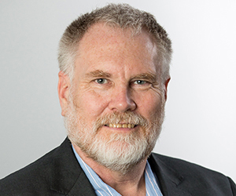
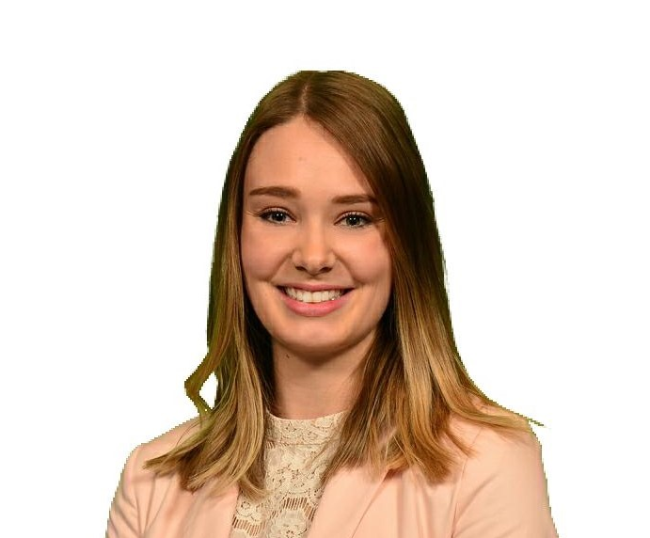

Session Presenters
Dean Crawford
Director, Shared Systems and Technology - BCNET
Devon Keys
Business Analyst, Shared Systems and Technology - BCNET

Slide 3






Shared Services
I’M A BIG DEAL
What our friends think we do
What our families think we do
What society thinks we do
What our members think we do
What we think we do
What we actually do
Notes:
Under 1minute
How we started – network
What are shared services? Nobody really knows

Slide 4



Overview
Why
What
How

Slide 5
Why
Why did BCNET pursue shared services and developed a private cloud for BC Higher Education
Notes:
START: 2:18pm
5 - 10 minutes

Slide 6
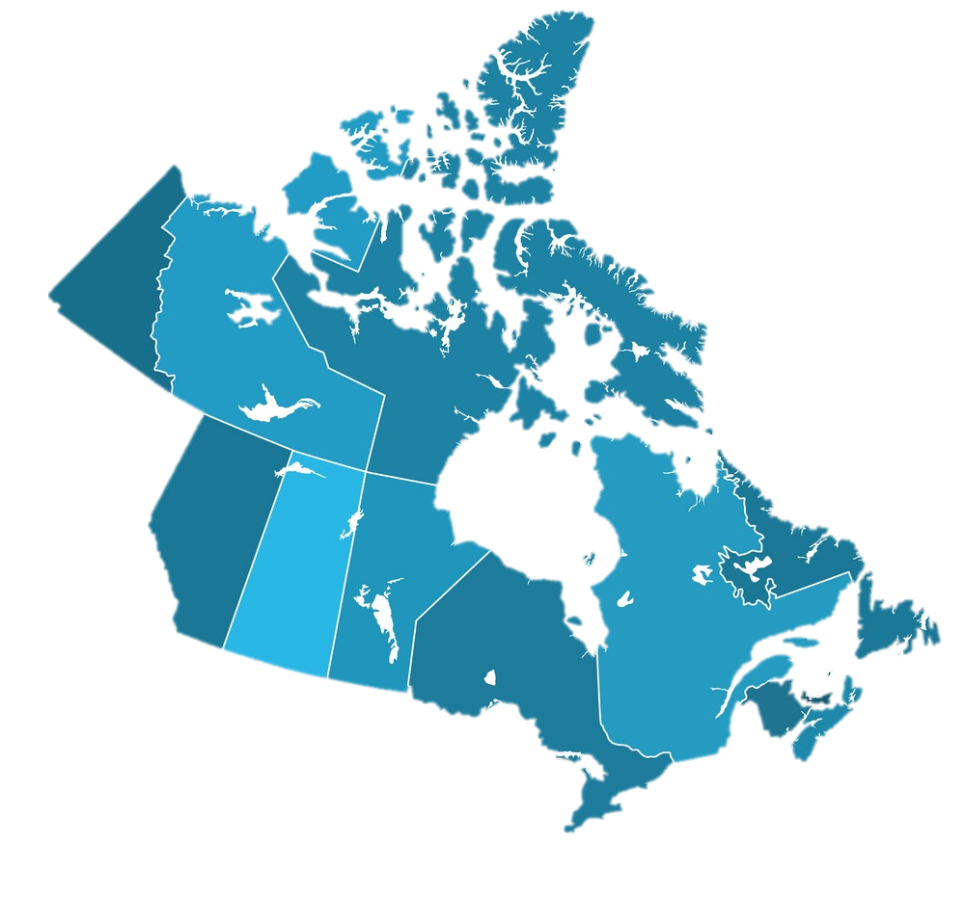


Regional Diversity
Notes:
Dean
Physical area is large with population gathered mostly in south west Alaska only larger state

Slide 7

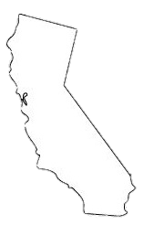

Regional Diversity
British Columbia
364,800 sq miles
5,034,000 (2019 est)
Vancouver
2,462,000 (2016 est)
Los Angeles
18,790,000 (2017 est)
Notes:
Physical area is large with population gathered mostly in south west Alaska only larger state

Slide 8
Student and Institutional Diversity
University of British Columbia | 46,465
Simon Fraser University | 22,161
University of Victoria | 16,767
British Columbia Institute of Technology | 12,962
Kwantlen Polytechnic University | 8,670
Thompson Rivers University | 8,561
Douglas College | 8,113
Langara College | 6,497
University of the Fraser Valley | 6,441
Camosun College | 6,194
Vancouver Island University | 5,956
Okanagan College | 5,365
Capilano University | 4,055
Vancouver Community College | 4,006
University of Northern British Columbia | 2,661
Justice Institute of British Columbia | 2,440
Royal Roads University | 2,154
Selkirk College | 1,739
College of New Caledonia | 1,590
College of the Rockies | 1,579
North Island College | 1,535
Emily Carr University of Art and Design | 1,425
Coast Mountain College | 779
Northern Lights College | 682
Nicola Valley Institute of Technology | 513
Largest Research Universities
Institutions in the southwest region of the province account for 87% of students
(155,851 of 179,310 students)
BC’s Indigenous PSI
Notes:
DEAN
FTE size difference
Ethnic diversity
Buying power by size

Slide 9
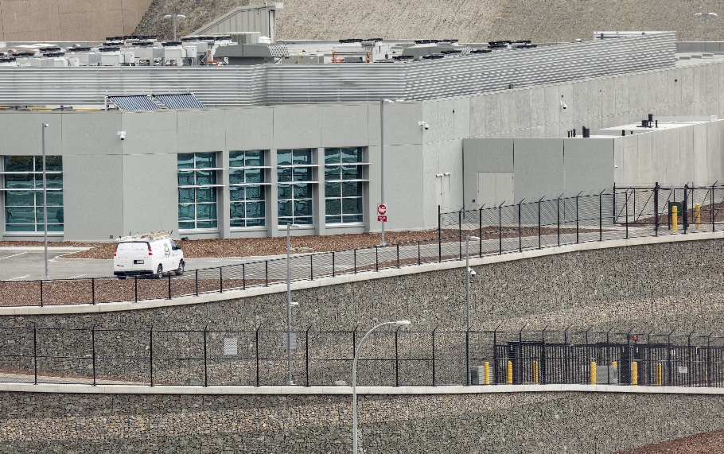
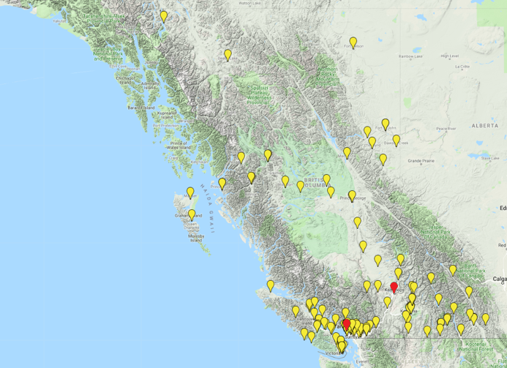
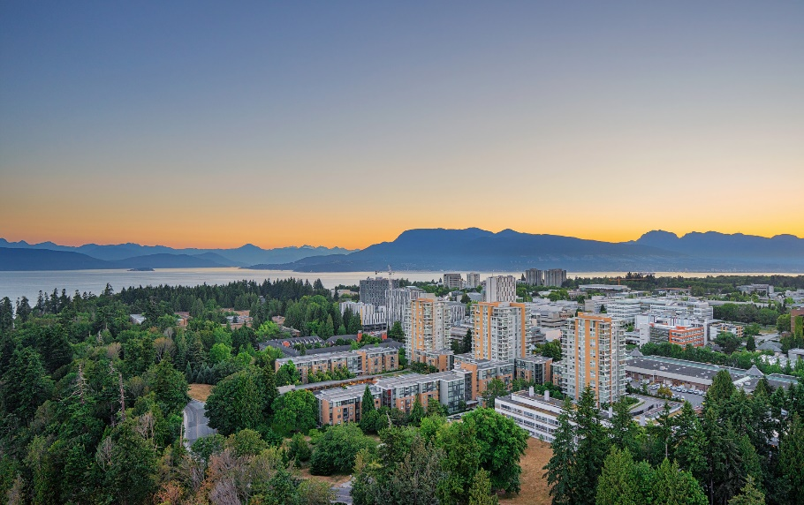
Geographic Diversity
Kamloops:
Co-located in Provincial Government Tier 4 Data Centre
Vancouver:
Co-located in member Tier 2-3 Data Centre
87%
Notes:
DEAN
Who are members are, PSI’s, Research Inst, Network connection vs shared services
For north east member to visit all sites in person it is a 2,000 mile road trip

Slide 10
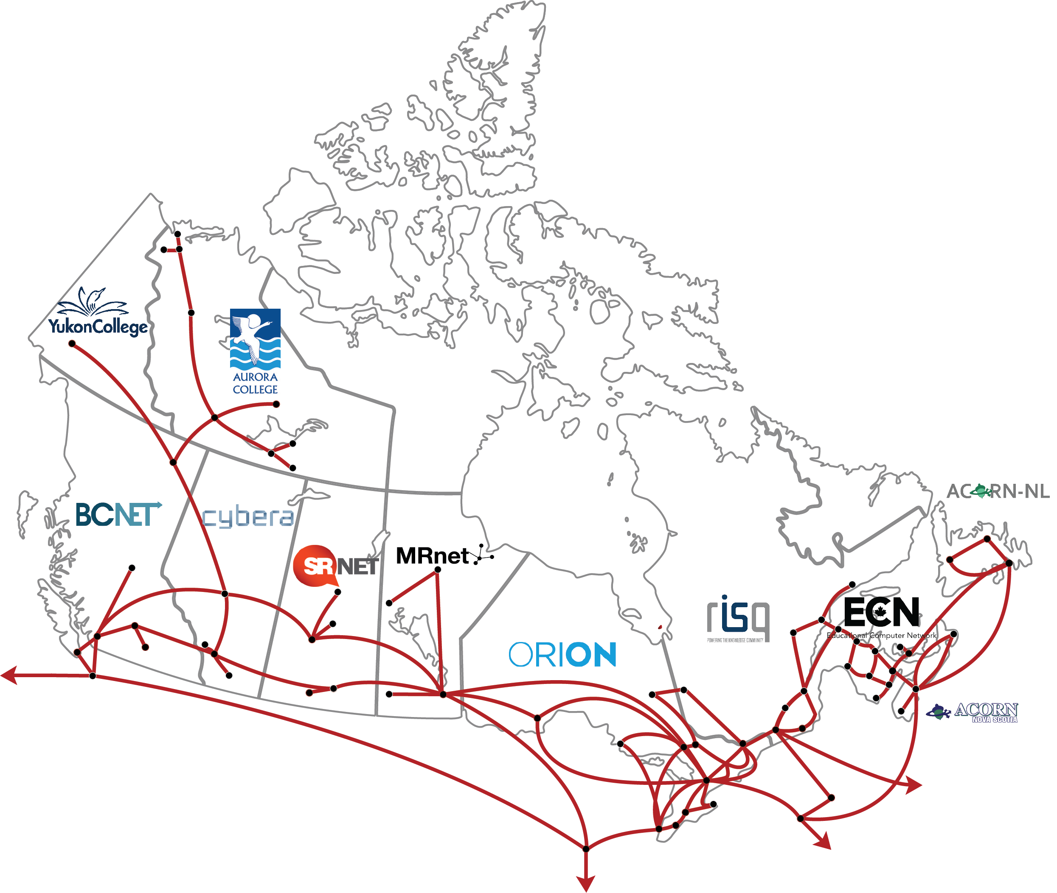

Our Network
Notes:
DEAN
Founded in network services – 3rd largest purchaser of commercial internet
CANARIE is the same as INTERNET 2

Slide 11
What
What are the shared service offerings that BCNET makes available to its members
Notes:
START: 2:25-2:30pm
Devon
5-10 minutes

Slide 12

Our Current Shared Service Portfolio
IT Shared Services
EduCloud – Server and Backup
DATA-SAFE
Video Conferencing (BlueJeans)
Digital Signage (Cool Sign)
Educational Technology
Desire2Learn
Moodle
LinkedIn Learning
Blackboard Collaborate
Info~Tech Research
Enterprise Licenses
Kaltura
SPSS
Survey Tool (SurveyMonkey)
TeamDynamix
IT Procurement
Microsoft
Adobe
Switches
Network Storage
Notes:
Devon
BlueJeans
- 3.6M and 61k meeting
Desire2Learn
TeamDynamix
- started 1 year ago and already 5 members
Sector contract

Slide 13
Current Member Participation
BCNET
Operated Services
BCNET
Managed Services
Aggregated
Licenses
Passthrough
Agreements
Notes:
Devon
- 25 potential members for participation
- Minimum threshold for starting services
- Highlight educloud as popular service

Slide 14
The legal parts
BC FREEDOM OF INFORMATION AND PROTECTION OF PRIVACY ACT (1996)
Protection of personal information
30 A public body must protect personal information in its custody or under its control by making reasonable security arrangements against such risks as unauthorized access, collection, use, disclosure or disposal.
Storage and access must be in Canada
30.1 A public body must ensure that personal information in its custody or under its control is stored only in Canada and accessed only in Canada
Notes:
Dean

Slide 15
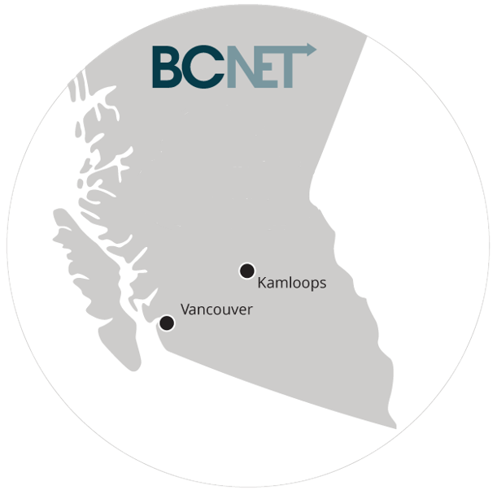
EduCloud
What
Private Virtual Cloud meeting all Provincial Privacy Requirements
Launch Date
October 2016
Metrics
23 Members
37 Virtual Data Centre
600 Virtual Machines
3,000 GHz CPU
10,000 GB memory
1.5 PB disk
Notes:
DEAN
What is EduCloud

Slide 16
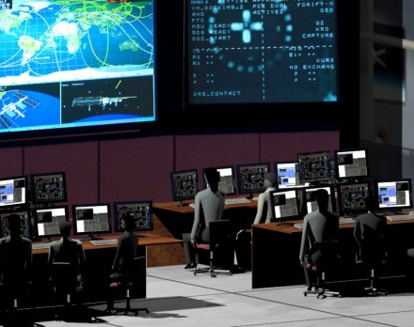
EduCloud
Operations
24/7 operations support
Annual billing to members
Self-serve for additional resources (billed quarterly)
No refunds for unused resources nor reallocation of resources
BCNET
Core foundation for BCNET services
  Kaltura, Digital Signage, Moodle, SPSS, Servers and Backup
  BCNET DNS, Wiki’s, Active Directory, Radius and other internal systems
Notes:
DEAN
How is EduCloud being used – BCNET services being hosted in educloud, how members use it

Slide 17
How
How does BCNET offer shared services to an entire province
Notes:
START: 2:35-2:40pm
15 minutes

Slide 18
How We Develop New Services
Service Inputs
Develop Rational
Privacy Impact Assessment
Launch Service
Member Poll
Approvals
Reviews
Pilot/Limited Release
Notes:
Service inputs: legal requirement, government, Board, member associations, committees/working groups
Rational: # and size of interested members, costs, savings, duplication
SSTC oversite
Annual service reviews

Slide 19
The Traditional Service Model
Vendor/Manufacturer
VAR
Member Institution
Participation Agreement
Member Institution
Vendor
Service Operator
SLA
Contract (potentially)
Contract
Notes:
DEAN
Traditional model is linear and has multiple levels of profit

Slide 20
Kaltura Service Model
Service owner
Vendor relations
Procurement/contract
What
Video sharing platform that integrates with your LMS
Launch Date
2016
Metrics
Hosted in EduCloud
15 institutions participating
125,000 student FTE
Kaltura
Vendor
UBC
On premise hosting (FIPPA)
Service operation
Participating Institutions
BCcampus
Tier 2 support
Notes:
Devon

Slide 21
Moodle Service Model
Service owner
EduCloud hosting
What
Open source Learning Management System
Launch Date
2014
Metrics
Hosted in EduCloud
8 institutions participating
Participating Institutions
Thompson Rivers University
Service Operator
Tier 2/3 support
Notes:
Devon

Slide 22
IBM SPSS License Service Model
What
  Statistical Processing for the Social Sciences
  Offer 4 SPSS license packages
Launch Date
  2017
Metrics
  20 participating members
  1,000+ licenses in circulation
IBM
Vendor
Vendor Relations
License Leasing
Server Host
Participating Institutions
Notes:
Devon

Slide 23




Our Value – Money and More
Cost Savings
Reliability
Trust
Vendor Management
Notes:
Devon
Cost Savings
Leverage BCNET’s buying power
Infrastructure, maintenance and staff costs
Vendor
Contract negotiations and renewals
Transparency and trust
Reliable
Dependable infrastructure - EduCloud
Dedicated/specialized service support staff
Trust

Slide 24
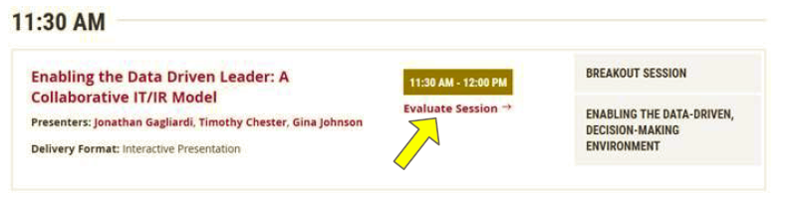
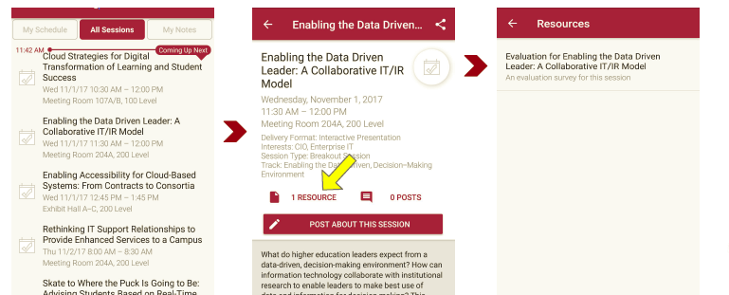
Session Evaluations
There are two ways to access the session and presenter evaluations:
1
2
In the online agenda, click on the “Evaluate Session” link
From the mobile app, click on the session you want from the schedule > then scroll down or click on the associated resources > and the evaluation will pop up in the list

Slide 25

Contact Information
Dean Crawford, Director, Shared Systems and Technology, BCNET dean.crawford@bc.net
Devon Keys, Business Analyst, Shared Systems and Technology, BCNET devon.keys@bc.net
Thank You
Questions?

